Slide 1
INSTALLATION OF SAMBA
DELIVERED TO:PETER WHEELER
DELIVERED BY:KULBIR SINGH DHINDSA

Slide 2
Installation of SAMBA
Firstly we have to create virtual environment by installing VMWARE workstation and after that install Window 7 and Android and then install Samba software in Android and use it to share or transfer files from window to android and vice-versa.

Slide 3
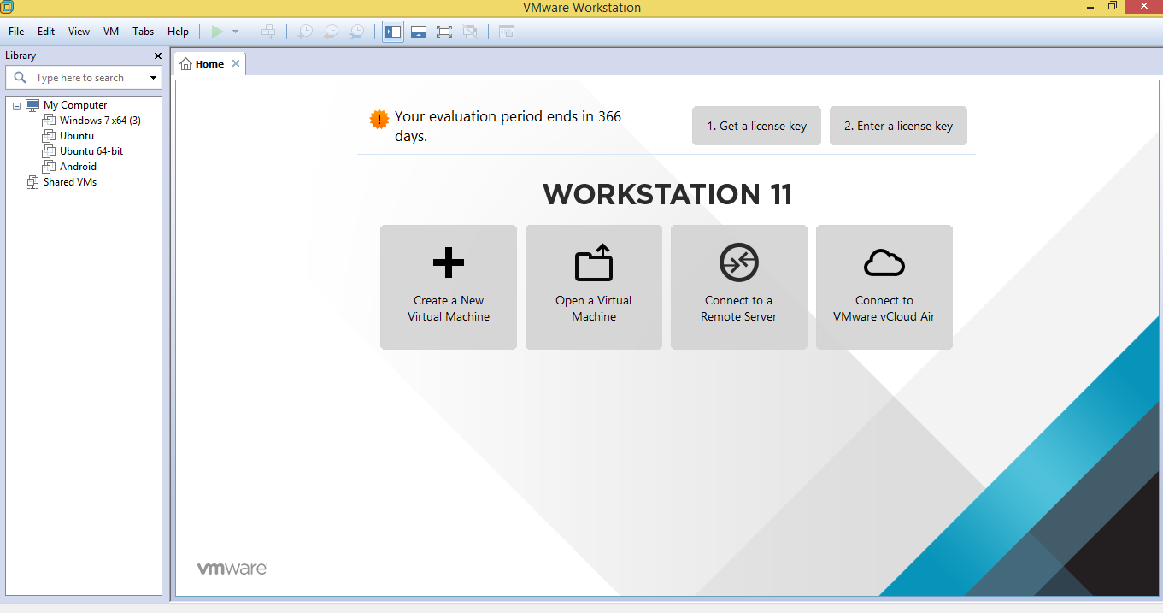
Installation of VMWARE Workstation 11
Environment of VMWARE Workstation 11

Slide 4
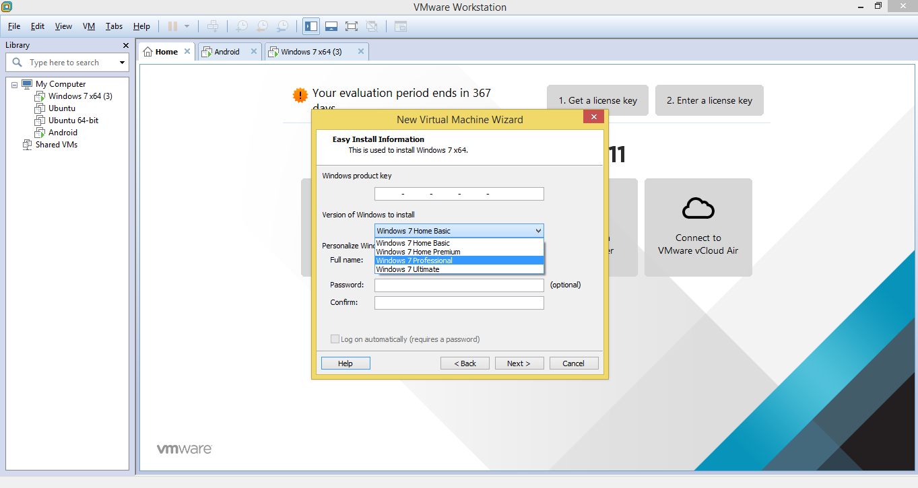
Installation of Window 7 in VMWARE

Slide 5
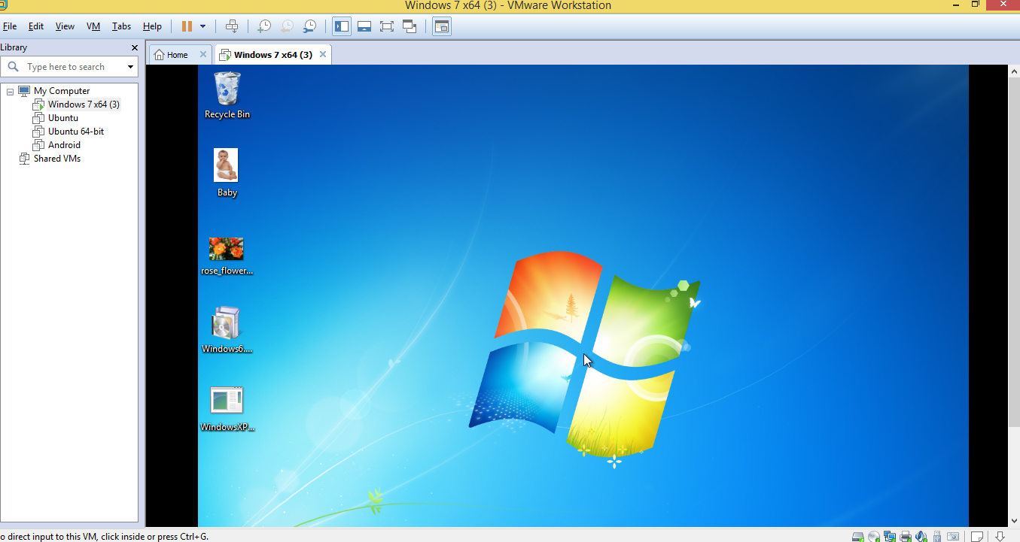
Environment of Window 7 in Virtual Machine Workstation.

Slide 6
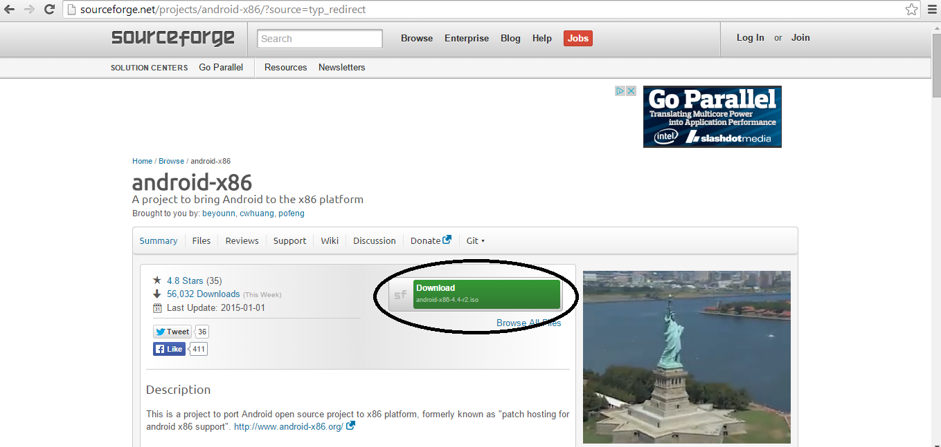
Installation of Android in VMWARE
First I downloaded android from here and after that I performed some steps.

Slide 7
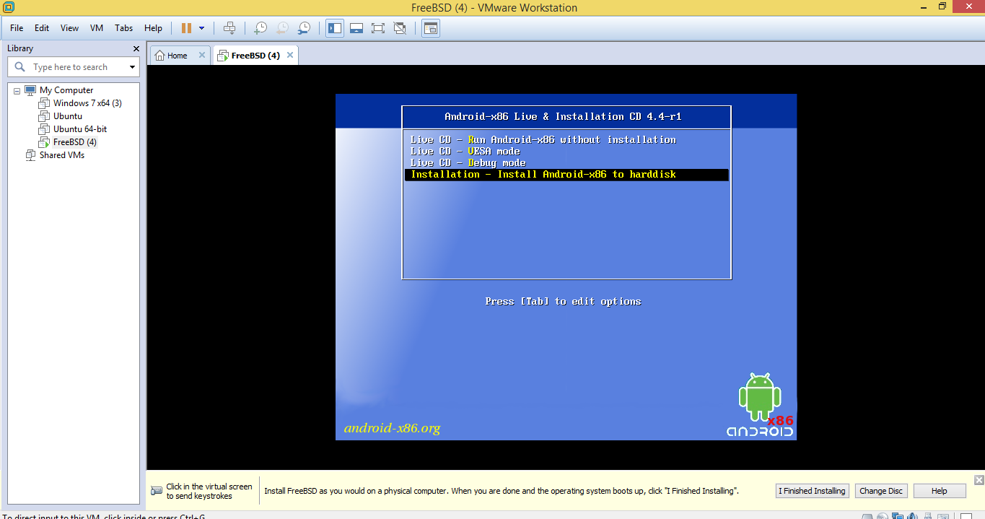
After performing some steps more I was able to complete installation of Android.

Slide 8
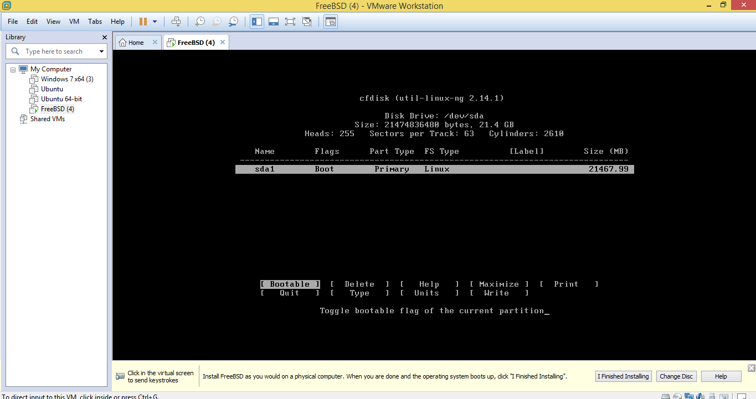
There are some more steps of completion of Android.

Slide 9
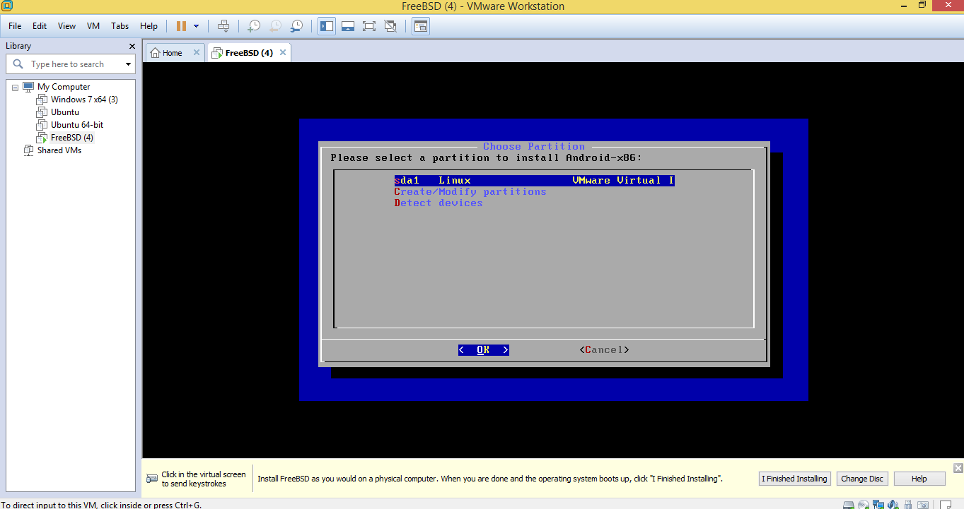

Slide 10
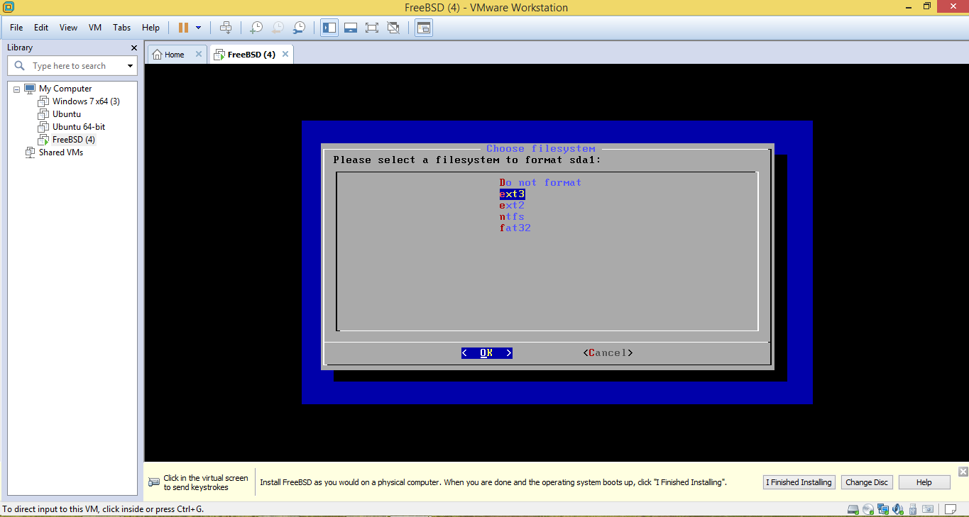
We can also select the filesystem to format sdal.

Slide 11
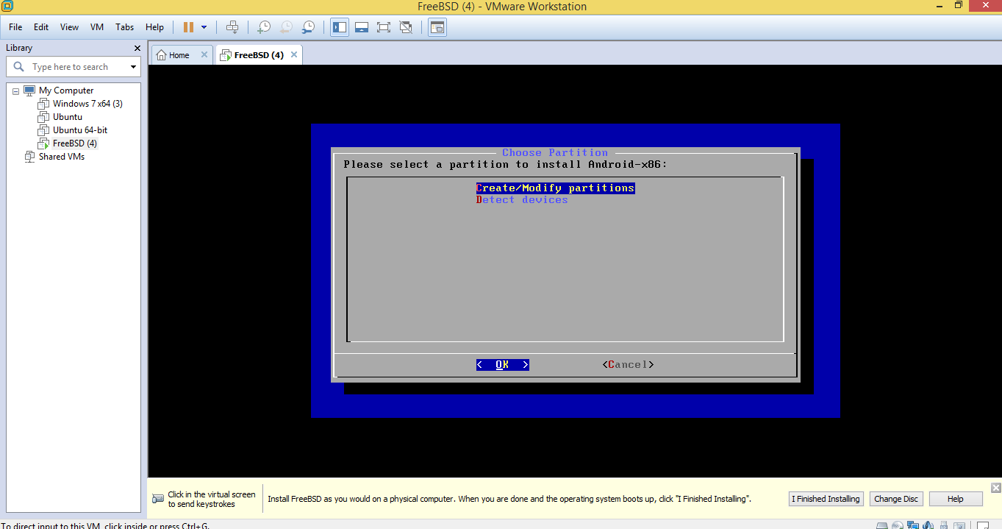
This step is to ask to select partition to install Android.

Slide 12
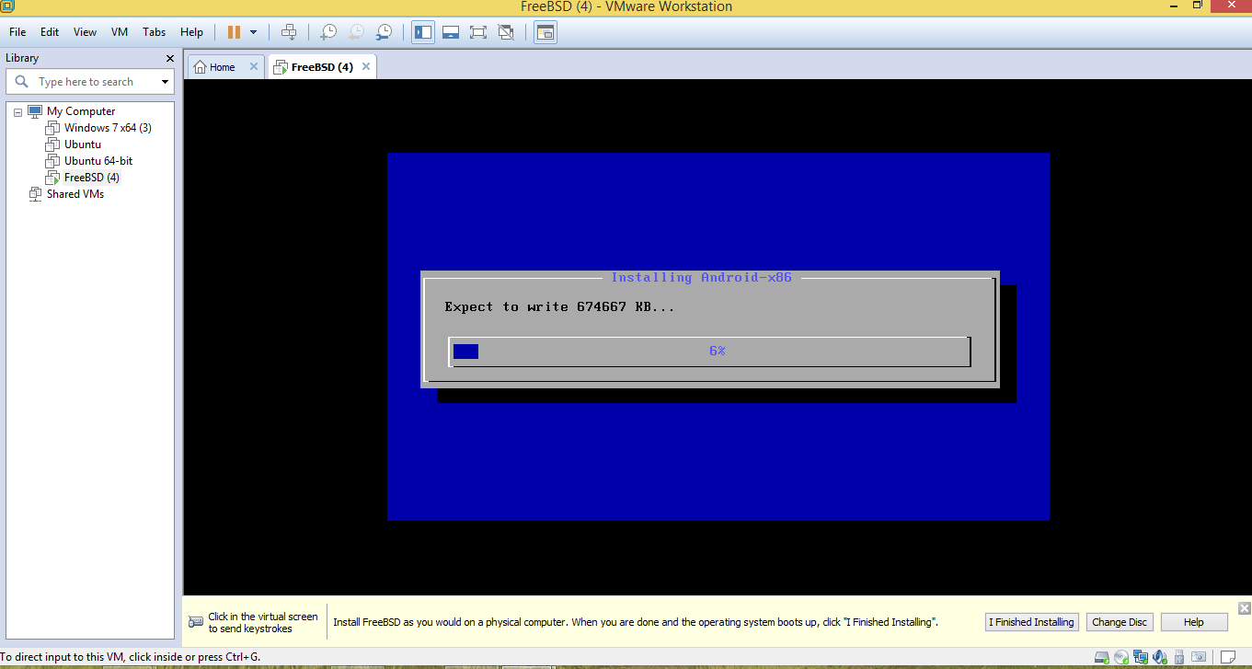
This is a last step of completion of Android.

Slide 13
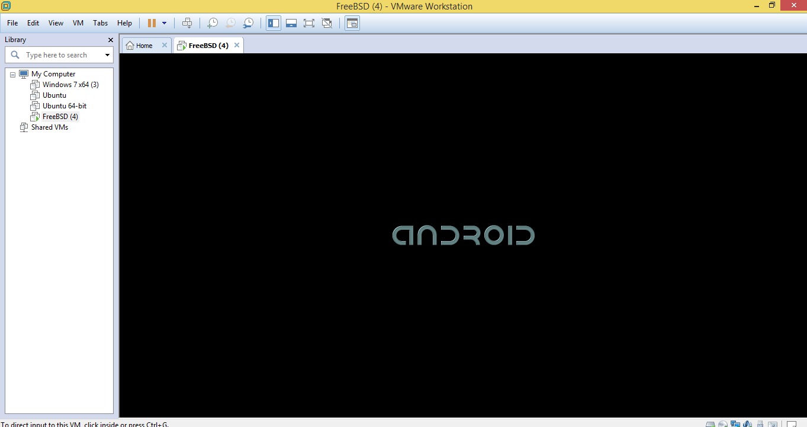

Slide 14
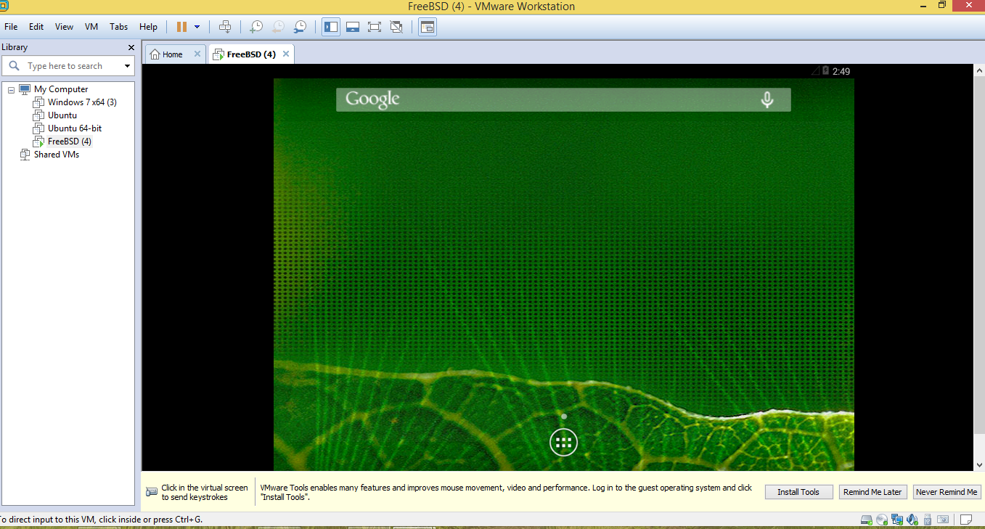
This is the main Android screen.

Slide 15
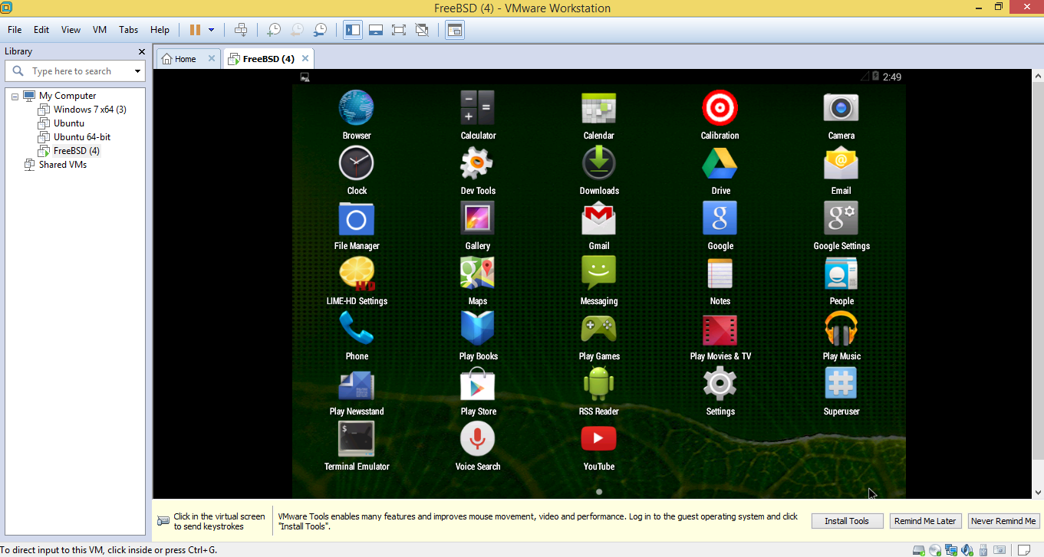
This is the Home Screen of Android. Now next step is to install Samba software.

Slide 16
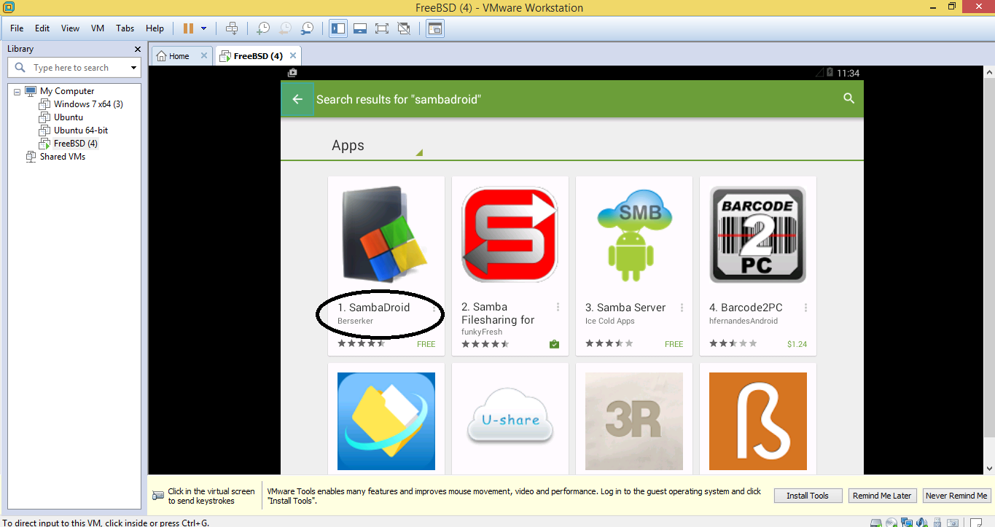
Now download and install SambaDroid.

Slide 17
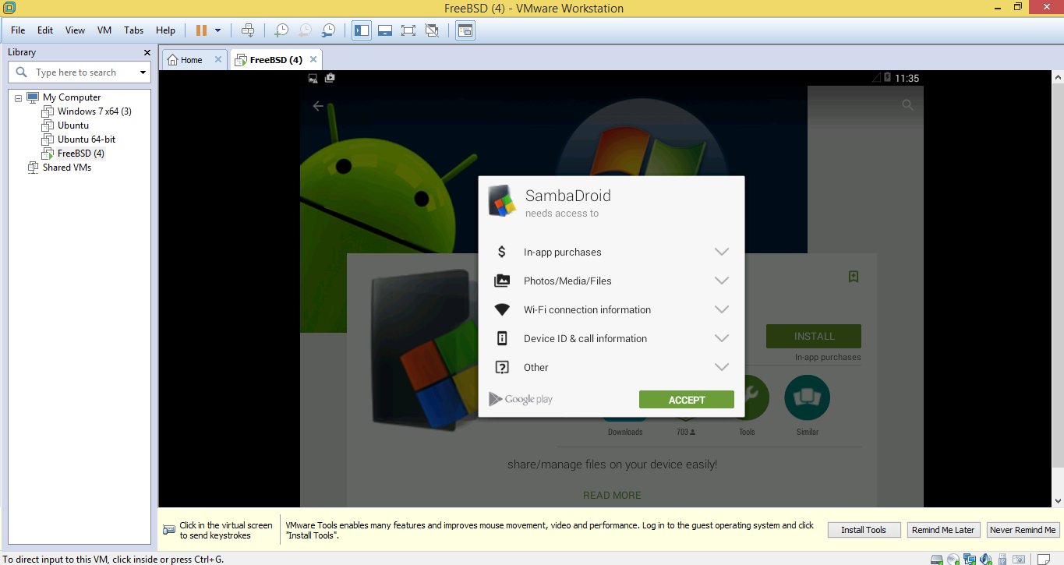

Slide 18
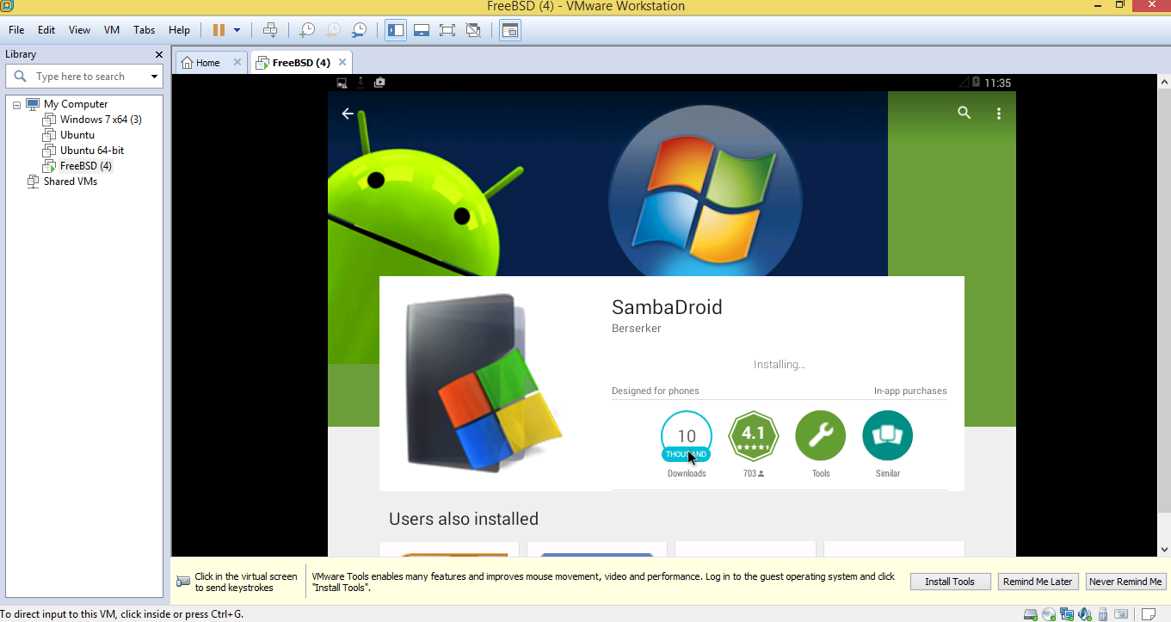

Slide 19
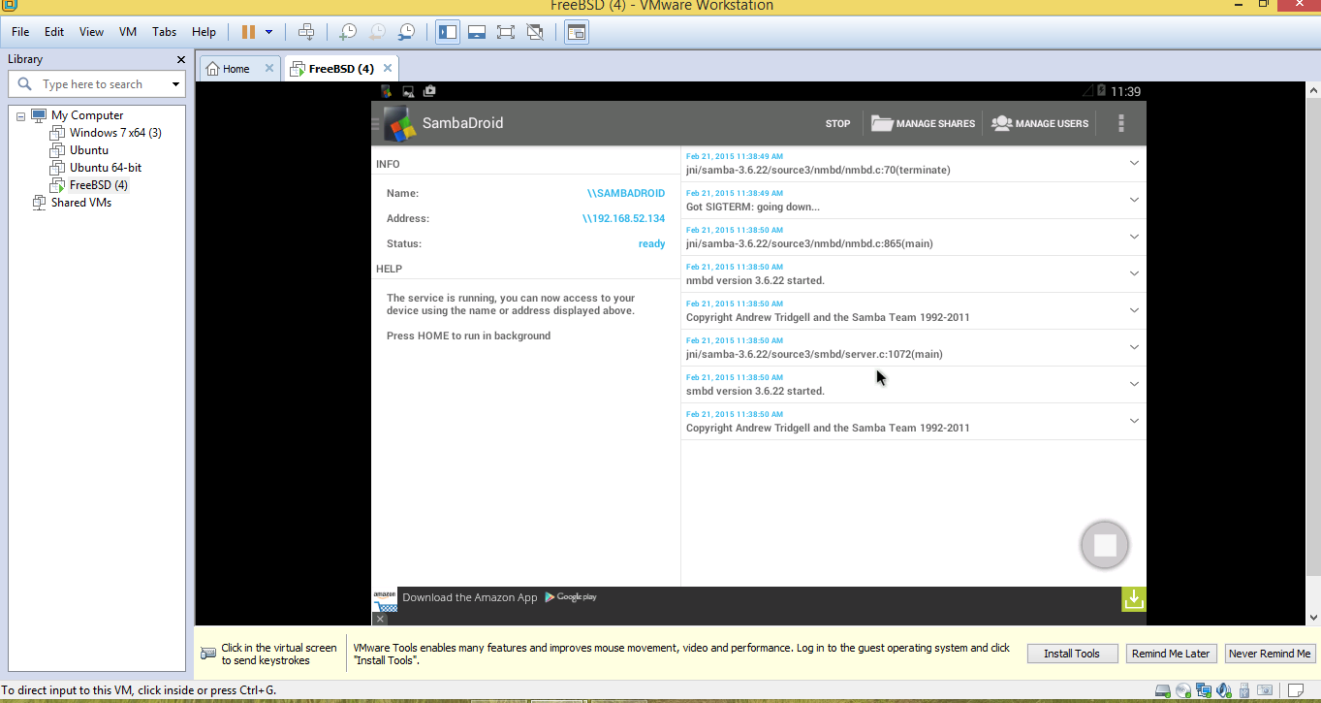

Slide 20
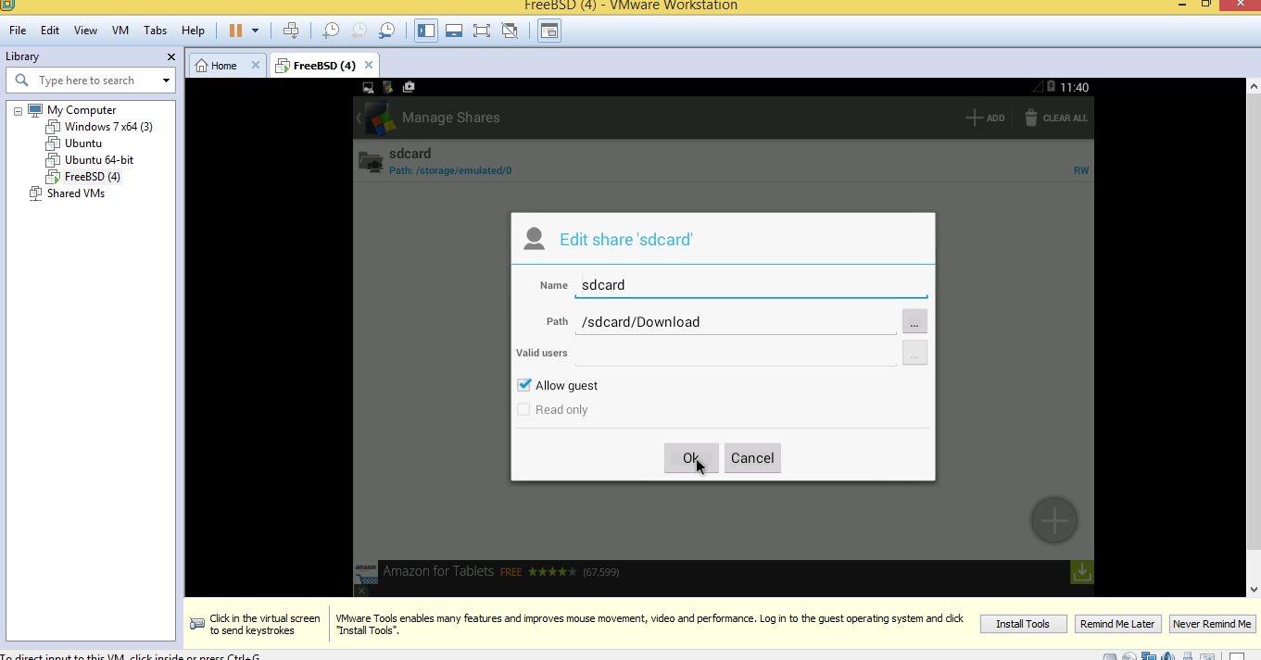
We can also edit the path of SambaDroid.

Slide 21
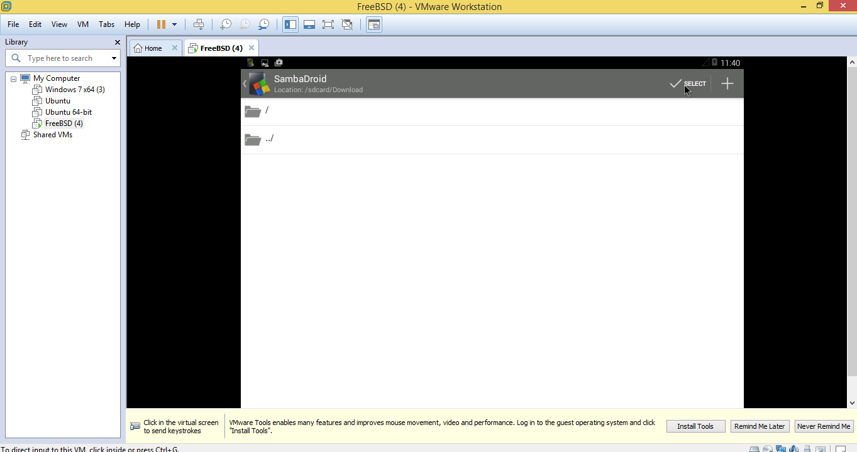
Now SambaDroid is installed.

Slide 22
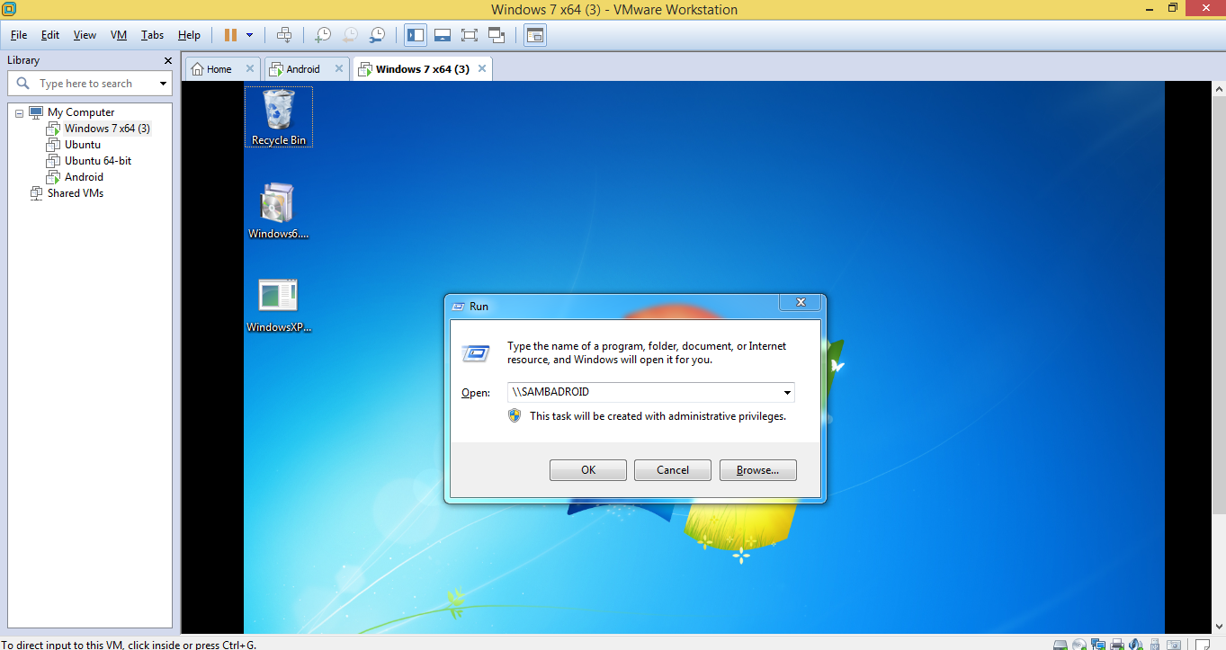
To open Android so that we can easily transfer files in Window 7 we run \\sambadroid command.

Slide 23
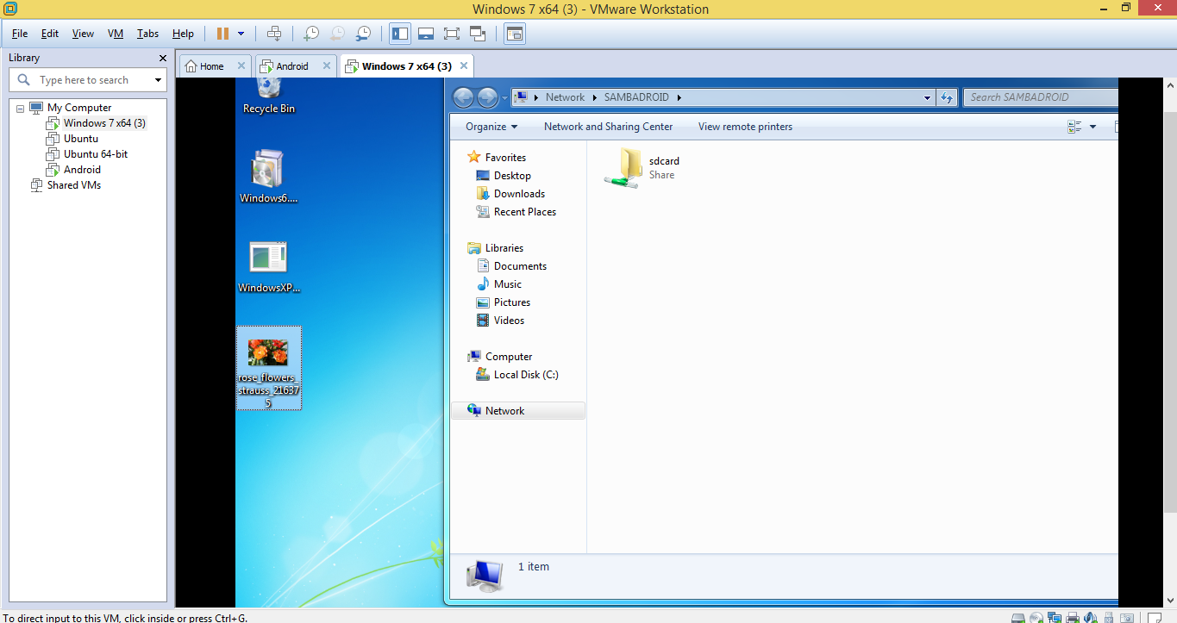
Open sdcard folder in android.

Slide 24
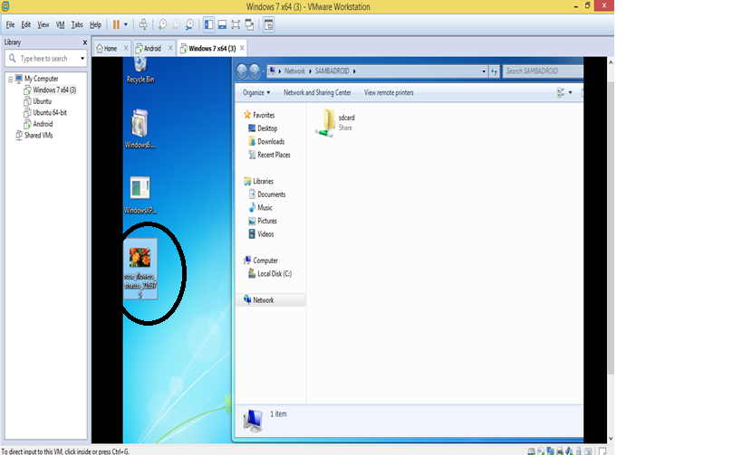
In Window 7 operating system, there is an image named roses_flowers and we transfer this image to android.

Slide 25
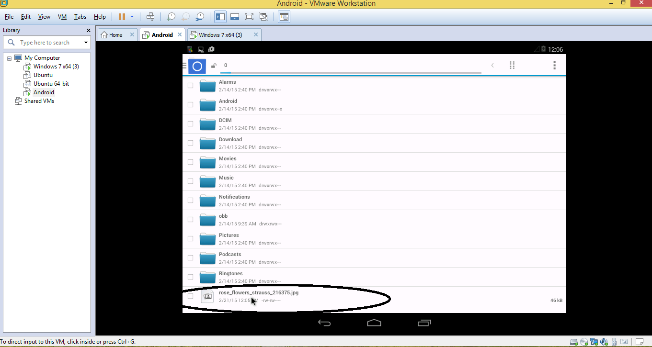
We can see in Android the transferred image.

Slide 26
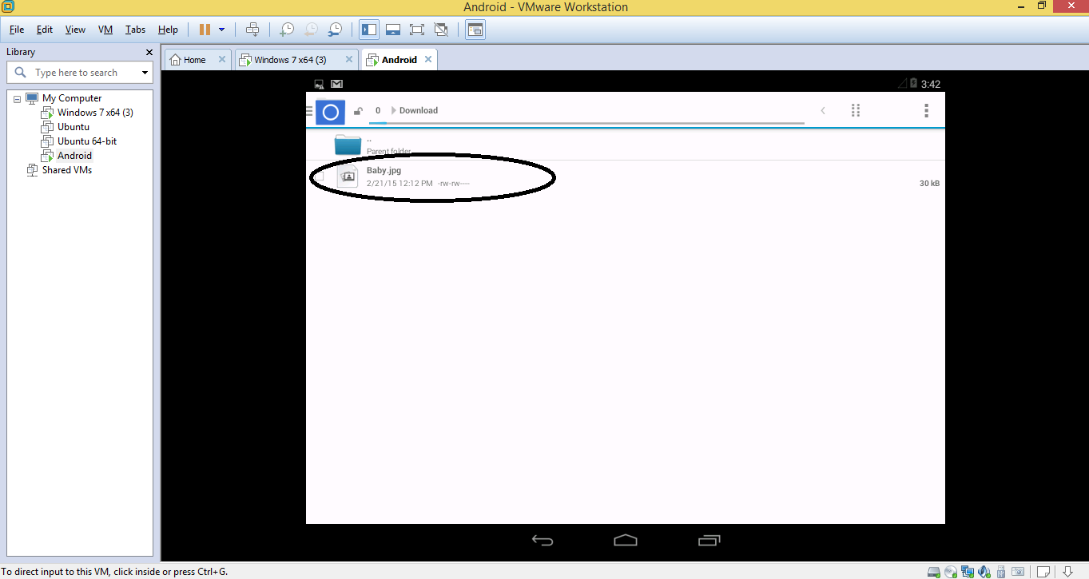
Now we transfer the baby image which is placed in android to window 7.

Slide 27
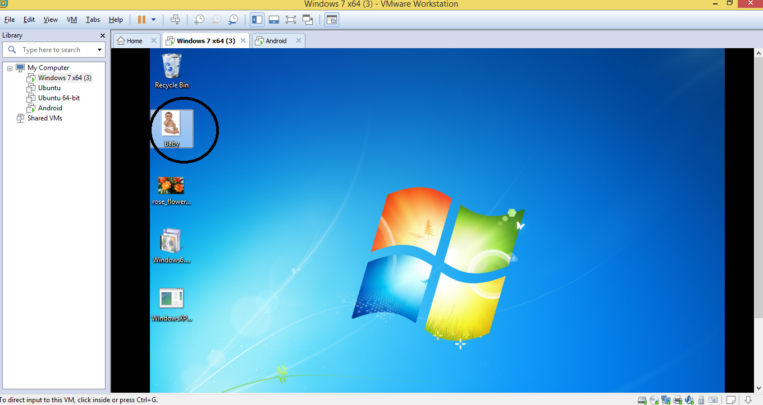
Here in Window 7 OS the baby image is transferred.

